Slide 1
Welcome!
Please review the steps on the screen before we get started.
Click here if you have a question.
Please mute your mic.
Prepare to participate in the session.
Click here to Chat and share comments.
Provide reactions of thumbs up or applause.
Please turn your camera on.

Slide 2

The Business of Nordic
©2025 Nordic®. All rights reserved. Confidential. Edition: 09/15/2025

Slide 3

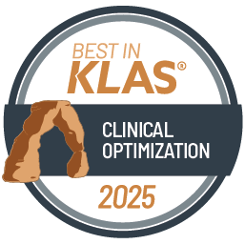
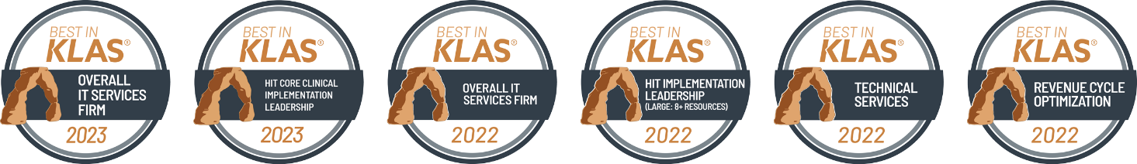
Global Health
and Technology Consulting
We connect people, data, and technology to create a healthier world.
7x
Best in KLAS
3,000+ Employees
900+
Clients
Notes:
Six combined Best in KLAS rankings in 2022 and 2023: Overall IT Services Firm x2, HIT Core Clinical Implementation Leadership x2, Revenue Cycle Optimization, and Technical Services
Highest KLAS rating among expansive firms for application managed services (AMS) and help desk services in 2021
7x named Best Place to Work in Healthcare by Modern Healthcare
5x named Top Place to Work in Healthcare by Becker’s Hospital Review
Named Best Company Culture, Best HR Team, Best Work-Life Balance, Best Career Growth by Comparably

Slide 4

Notes:
If there is one thing so far to remember, it would be our Mission Statement. Nordic connects people, data, and technology to create a healthier world.
https://youtu.be/T2IAStVayL0

Slide 5
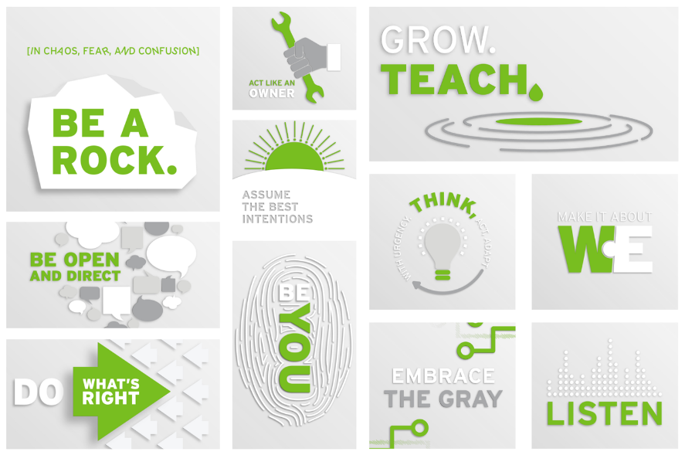
NORDIC’S MAXIMS
Notes:
Breakout Rooms
The 11 Nordic maxims are our guide to doing good. They shape who we are, what we do, and how we interact with those around us.
Be You. - There's only one you. Your background and experiences are like no other. Your individuality sets you apart. It's our uniqueness – fully embraced – that helps to make us Nordic.
Make it about "We". - Collaboration is critical to our success. It's how we work. With everyone. Collaboration allows us to capture the best of our wisdom and creativity.
Listen. - Listening is the first step to any answer. It's a skill that helps us solve problems and discover more innovative solutions. It's an art that we must actively practice to ensure the right outcome.
Embrace the Gray. - Not everything is black and white. The unknown challenges us to explore strategies and pragmatic solutions that aren't yet defined.
Assume the Best Intentions. - Great minds don't always think alike. Sometimes ideas and opinions differ, but remember, we're all working in the best interest of all parties.
Be Open and Direct. - When you are honest and transparent, good things happen. So don't be afraid to have the difficult conversation or face the tough situation. Just remember to be supportive and understanding.
Do What's Right. - When confronted with any decision, always do the right thing, not just what's easy. When you focus on the fair and ethical path, you can't go wrong.
[In chaos, fear, and confusion] Be a Rock. - Ours is sometimes an unpredictable and unforgiving business. Be the calm before, during, and after the storm.
Think, Act, and Adapt with Urgency. - Gather information. Get going. Be ready to change. Sometimes the situation at hand requires thinking on your feet.
Act like an Owner. - Show passion and enthusiasm for everything you do. Take ownership, not only of your work, but the greater success of all parties. Be a role model in all your decisions and responsibilities.
Grow. Teach. - Knowledge is always more powerful when it's passed from one person to another. Keep learning and sharing. Keep growing yourself and those around you.

Slide 6

Notes:
https://youtu.be/QyNp3YYaZvo

Slide 7
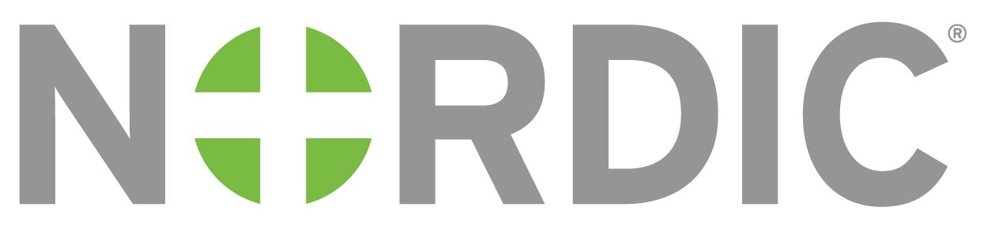
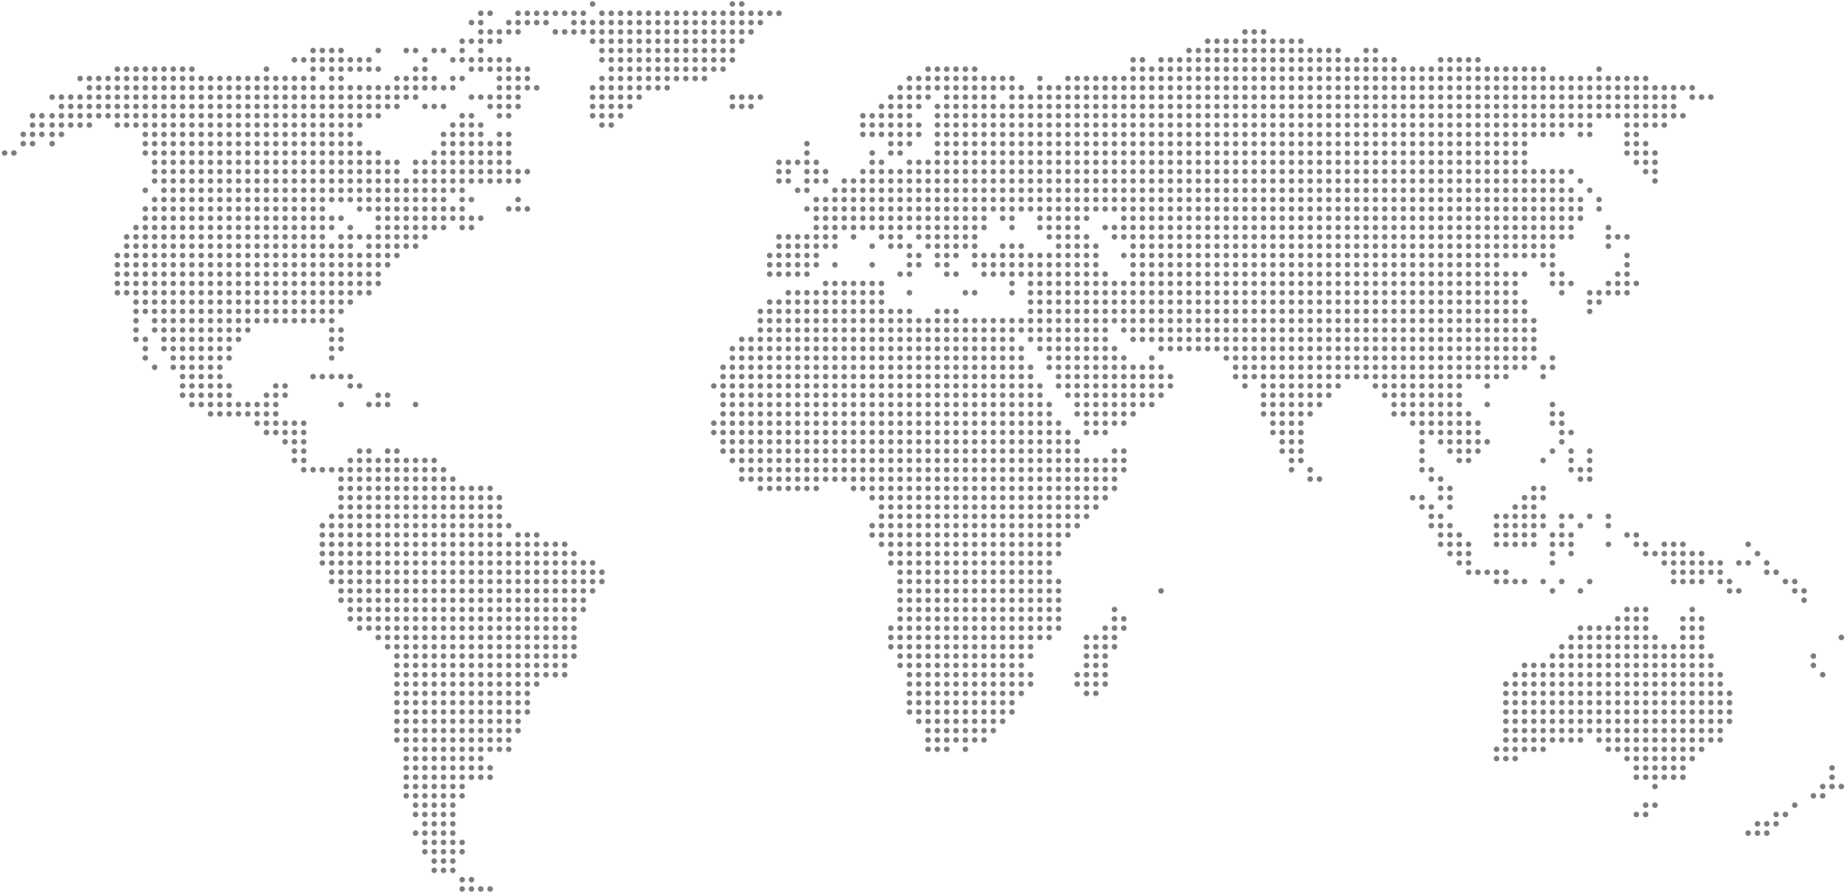
Global Health
and Technology Consulting
Global Footprint
Montreal
Wisconsin
Netherlands
Ireland
Toronto
Philippines
Texas
UK

Slide 8
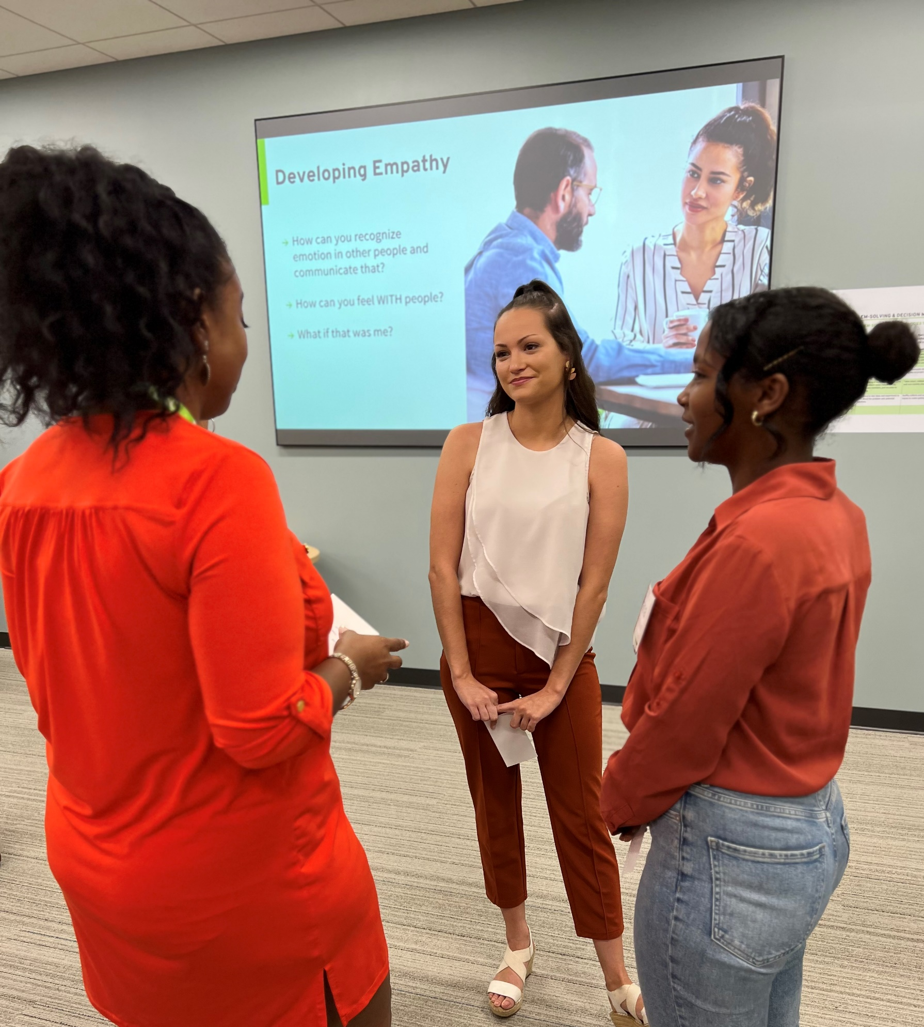
Nordic’s Culture & Engagement
Employee Resource Groups (ERGs)
Community Matters Events
Equitable Recruiting Practices
Anti-Bias Training
Culture & Engagement Surveys
8

Slide 9




Nordic’s Context: The “Big Squeeze”
NEW COMPETITORS
CARE COMPLEXITY
CHANGE FATIGUE
RISING COSTS
CONSUMER DEMANDS
REDUCED COVERAGE
LABOR SHORTAGE
POORER HEALTH
Notes:
Today we live in an era known as “The Big Squeeze”, a phenomenon that presents ongoing challenges to healthcare organizations across the globe.
In the US, the big squeeze impacts profitability, while elsewhere it creates service constraints, leading to long wait times for patients, or getting less healthcare than before for the same amount of money.
There is not a single healthcare organization that isn’t being squeezed in one or more of these areas, and Nordic is able to help organizations make meaningful progress toward better outcomes.
< CLICK >
New competitors – disintermediation taking out the middleman direct to market sales from Amazon and ZoomCare to patients
Care complexity – the Baby Boom generation, largest population segment, is requiring more complicated healthcare as they age
Provider burnout – leads to high turnover and retraining costs as medical workers are quitting
Rising costs – healthcare expenditures grew 8% in 2024, 7% in 2025, outpacing growth in GDP
Technology gaps – Rapid adoption of telehealth, AI diagnostics, is outpacing IT infrastructure, leading to cybersecurity risks, data silos, and workflow inefficiencies.
Reduced coverage – One Big Beautiful Bill has reduced Medicaid coverage for millions of Americans
Labor shortages – vacant roles mean clinics and hospitals have to put more work on existing staff and/or hire less qualified workers
Financial pressure – sluggish economic growth in US, inflation,

Slide 10
Nordic’s Context: The “Big Squeeze”
NEW COMPETITORS
CARE COMPLEXITY
CHANGE FATIGUE
RISING COSTS
CONSUMER DEMANDS
REDUCED COVERAGE
LABOR SHORTAGE
POORER HEALTH
Notes:
Today we live in an era known as “The Big Squeeze”, a phenomenon that presents ongoing challenges to healthcare organizations across the globe.
In the US, the big squeeze impacts profitability, while elsewhere it creates service constraints, leading to long wait times for patients, or getting less healthcare than before for the same amount of money.
There is not a single healthcare organization that isn’t being squeezed in one or more of these areas, and Nordic is able to help organizations make meaningful progress toward better outcomes.
< CLICK >
New competitors – disintermediation taking out the middleman direct to market sales from Amazon and ZoomCare to patients
Reduced coverage – One Big Beautiful Bill has reduced Medicaid coverage for millions of Americans
Technology gaps – Rapid adoption of telehealth, AI diagnostics, is outpacing the ability of many healthcare systems to modernize their IT infrastructure, leading to cybersecurity risks, data silos, and workflow inefficiencies.
Care complexity – the Baby Boom generation, largest population segment, is requiring more complicated healthcare as they age
Provider burnout – leads to high turnover and retraining costs as medical workers are quitting
Labor shortages – vacant roles mean clinics and hospitals have to put more work on existing staff and/or hire less qualified workers
Rising costs – healthcare expenditures grew 8% in 2024, 7% in 2025, outpacing growth in GDP
Financial pressure – sluggish economic growth in US, inflation,

Slide 11



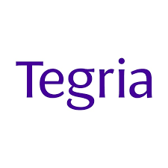


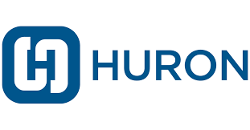
Nordic’s Market Position
BROAD CONSULTING
CAPABILITIES
EXPERTS IN EHR
IMPLEMENTATION
Notes:
Nordic has several competitors in the market, vying for the opportunity to partner with healthcare organizations to address their struggles.
ASK: By a show of hands, how many of you have heard of any of these consulting firms?
Wait for people to raise their hands.
We chose to put the firms on the left together for a reason and the firms on the right together for a reason. Take a moment to do a quick google search to figure out why we put them in those groups. I’ll call time in about 60 seconds so that we can chat more as a group.
Wait for people to research.
Ok, what did you find out?
Wait for people to share, respond as needed. Call out people by name if needed.
< CLICK >
Deloitte, Ernst & Young, PWC, and KPMG are firms that are well known for their broad consulting capabilities. They can and do consult in the healthcare space, but they also work in many other markets, helping clients strategize at a high level.
We also have competitors specific to the EHR space. Evergreen, Tegria, and Huron are a few examples of firms that specialize in EHR implementation. They advise strategy for clients in this area, and also provide staffing to assist with their implementation projects.
ASK: So, which group does Nordic fit in?
Wait for people to share, see if the “lightbulb” goes on for someone that sees the unique spot that Nordic sits in.
< CLICK >

Slide 12

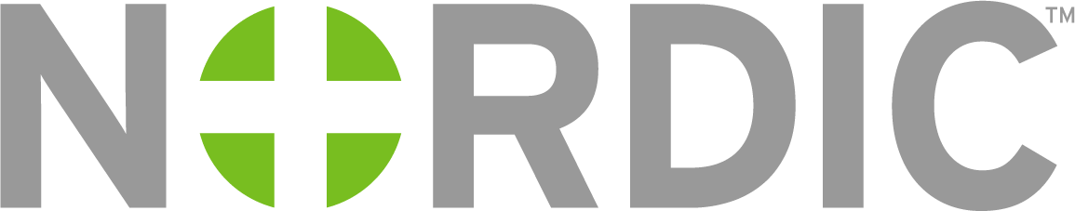
THE SWEET SPOT
BROAD CONSULTING
CAPABILITIES
WE CAN DO THINGS OTHER FIRMS CANNOT
EXPERTS IN EHR
IMPLEMENTATION
Notes:
Nordic has a sweet spot in the market. We have broad capabilities like the big strategy firms, and we also have deep technical knowledge and expertise in the EHR space that allows us to compete against those niche firms.
When we put those capabilities together, Nordic can do things other firms cannot.
< CLICK >

Slide 13
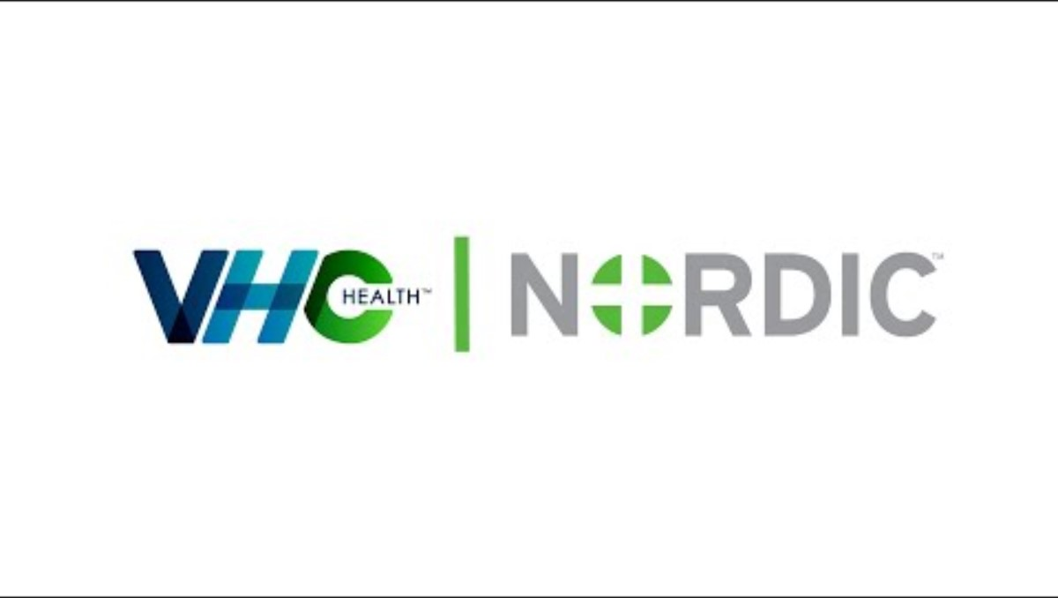
Notes:
Clients choose Nordic because of our unique capabilities, so let’s listen to what one our client CIO’s has to say about us.
Please write down something from the video that stands out to you so that we can chat about it later.
Niki will put a link to the video in the Chat for those that are not able to see it in the presentation.
< CLICK >
https://youtu.be/LERKn023zsc?si=u6LzpS80tzLIbexm
Article: https://nordicconsulting.sharepoint.com/sites/NordicHQ/NordicHQStories/Pages/Stories/Pf98Y0WOEBOGJH7In8o8w/76157a2a-9df8-4948-a5de-f36e45b17095.aspx

Slide 14
What stood out to you about Nordic’s value?
Notes:
This is one of my favorite quotes from the video.
It captures what makes Nordic stand out in the industry and why we own such a unique place in the market.
I’d love to hear from the group on this. What stood out to you from the video? Please feel free to come off of mute to share your thoughts or add them to the chat.
Look to chat for responses.
Mission is simple, it’s just to be the best health system.
The only way to get to the level we wanted to was to jump into the digital space.
Expanding access to care, improving patient satisfaction. Improved self-sufficiency for patients. 1-11 philosophy, 1 patient, 1 consent, once a year.
< CLICK >

Slide 15







Nordic’s Business Lines
Digital and Cloud
Process Improvement
Migration of data to online hosting platforms.
Optimize clinical and financial efficiency.
EHR Services
Staffing Services
Installation of electronic health records.
Provide skilled workers.
ERP Services
Managed Services
Implementation of HR systems.
Long-term IT and tech support.
CRM Services
Installation of client relationship management systems.
Notes:
These are not employee divisions or our team structure. They are the main ways we generate revenue. Not of equal size. (But then – what is CP selling, per se? I mean, everything I guess.)
Advisory Services vs. Staffing Services vs. Consulting Services?
Consulting Services is “HR of consultants,” the group that intakes all consultants, then farms them out to the appropriate business line. CS itself is an internal service, not a business line.
Staffing Services = A business line that fills a staffing need at a client site, which is typically just a one-off need (I need a Cadence analyst for 3 months).
Advisory Services = A business line that helps hospitals by giving them advice on strategic needs, such as performance improvement
Affiliate Solutions = A business line that helps hospitals roll out Epic to community clinics.
EHR Services = A business line that helps hospitals install an EHR
Sheryl:
Great question, as these terms are super confusing.
Consulting services is the team responsible for consultant hiring, management, and placement. We aren’t a business line, but a department within the organization.
Staffing services, or staffing, is its own business line. When we sell a client a single role (a backfill for an analyst, for example), this role is classified as staffing. We have consultants who are on staffing projects/roles. I’m not sure staffing services is really a thing anymore. Our team was called staffing services for a short period of time but that has changed. Staffing, however, is very much a thing and always will be. This is what our business was founded on.
Advisory services is an umbrella term used for the groups within Nordic that provide services focused on strategy, technology, and performance improvement. Those groups are Digital Health, Implementation Services, and Performance Improvement.
Affiliate services is housed within Implementation services. We have in-house experts in areas such as mergers & acquisitions and community connect, which are two ways in which healthcare organizations work together and utilize the same instance of Epic. These projects are more nuanced than a first time install, which is why we have a team to support these projects.
Our CS consultants fill roles for all of our business lines. They are still called consultants in each case, but the type of project they are supporting will be linked to a different business line.
A CS consultant might fill a staffing need at a client site, which is typically just a one-off need (I need a Cadence analyst for 3 months).
A CS consultant might be on an affiliate project, helping to roll out Epic to community clinics.
A CS consultant might be an analyst on a performance improvement project.
A CS consultant might be part of an implementation project.
LINNEA
There’s something I still do not quite understand about Managed Services. I know there are different categories within MS. Which of the following is correct?
A. ALL of MS consists of different kinds of outsourced help desks.
B. One of the categories of work within MS is outsourced help desks, but there are other kinds of MS work as well.
C. None of the above.
B! We have multiple types of helpdesks that can be outsourced to Managed Services, such as clinical help desk (aimed at clinical users with Epic issues), technical help desk (for all sorts of technical issues) and patient portal help desk (for patients with MyChart issues). Those are all considered “Tier 1” support. The next tier is “Tier 2” support which is when they need to pass the issue off to an analyst for a deeper dive. That would include my team for “AMS”- Application Managed Services. And then we also have Service Management and Project Management as a service as well.

Slide 16
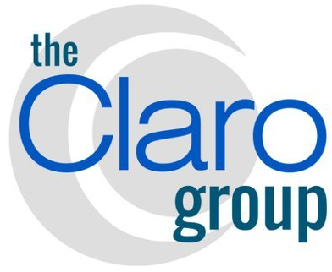




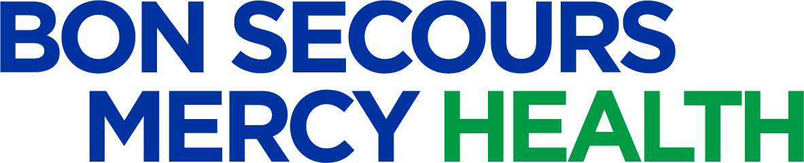

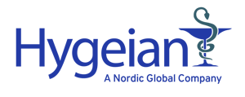

Nordic’s Mergers & Acquisitions
Notes:
In 2009 the US Congress passed the HITECH Act (Health Information Technology for Economic & Clinical Health) This moved forward the adoption and meaningful use of Electronic Healthcare Records (EHRs) This was to improve quality, safety and efficiency. Ensure privacy and security. Increase coordination of care. Engage patients in care and improve the health of the population.
In January of 2010, Nordic was founded by two former Epic employees.
Healthtech
Healthtech is based in Canada, specializing in health and technology consulting and operating within a universal healthcare environment. The team's experience and certifications with a vast variety of systems have enabled it to deliver clinical, operational, and financial improvements to healthcare clients for over 35 years.
Bails/ERP Services
ERP Services (formerly known as Bails) delivers the "and technology" consulting component to clients worldwide. With expertise in healthcare and beyond, Bails helps companies in many industries implement, manage, and maintain back-office processes and software. Using proven Infor Deployment Methodology, Bails has enhanced clients' business operations for 25 years.
S&P
S&P's expertise includes clinical, revenue cycle, integration, strategic planning, reporting, and project/program management. In addition, we have an extensive Laboratory IS team fluent in Cerner, Clinisys (fka Sunquest), SCC Soft, and most mainstream LIS systems.
Accrete Health Partners
Accrete Health Partners acquired Nordic Consulting in June 2022. The partnership will anchor Accrete’s growing portfolio, expand Nordic’s health care technology services, and accelerate end-to-end efficiencies for patients, providers, and health systems, primarily in the Managed Services space. Together, we will improve I&T operational performance, capabilities and capacity for our clients.
One of the 2023 Outcomes from Nordic’s Strategic Plan is ‘Improve client digital service delivery.’ The BSMH and RSFH Agreements, highlighted below, help us achieve the goal of ‘Creating a set of offerings from IT assessments through full Managed Services that help our clients right-size their spend and deliver top-of-class digital services and operations to their organizations.’
Bon Secours Mercy Health (BSMH) and Roper St. Francis Health (RSFH)
Nordic expanded its offerings to include a full suite of Managed Services by adding Bon Secours Mercy Health (BSMH), one of the nation’s 20 largest healthcare systems, and Roper St. Francis Healthcare (RSFH), a 657-bed system with 117+ facilities, as clients in July 2023. BSMH and RSFH Information and Technology teams will join Nordic to build an end-to-end managed services organization, focused on serving the healthcare industry. This addition advances Nordic with the innovative, patient-centric capabilities BSMH and RSFH have developed to support world-class patient care for future engagements.
Hygeian
Hygeian is healthcare consulting company based in the United Kingdom. Hygeian has a strong network of 300 highly experienced and skilled management consultants - with a wide range of expertise from clinical, financial, and technical backgrounds - supporting both public and private sector clients across the UK and the Middle East
Nordic Europe
Focusing outside of North America, Nordic Europe helps clients navigate their systems and workflow challenges to meet strategic health and technology needs. Nordic Europe supports clients by navigating the specific requirements of each region, country, and health system with creativity, flexibility, and determination. Locations in Ireland and The Netherlands
Nordic Middle East
We deliver targeted expertise with a focus on value versus cost alone. From hospitals serving local communities to healthcare organizations with nationwide coverage, we believe collaboration across clinical teams and digital initiatives will lead to a healthier population and streamlined processes that benefit providers and patients alike. Located in Dubai
Strategic Advisory
Clinical and Operational Performance Optimization
EHR Implementation and Benefits Realization
BSMH & RSFH
In alignment with our 2023-2025 strategic plan, We are expanding our offerings to now provide our clients with a full suite of managed services. This move represents an evolution from primarily focusing on EHR-agnostic, point solutions to an enhanced portfolio that delivers end-to-end IT support. We are beginning this journey by working with a group of foundational clients, Bon Secours Mercy Health (BSMH) and Roper St. Francis Healthcare (RSFH), who both have an innovative, patient-first approach to information technology.

Slide 17
Nordic’s Mergers & Acquisitions
Notes:
In 2009 the US Congress passed the HITECH Act (Health Information Technology for Economic & Clinical Health) This moved forward the adoption and meaningful use of Electronic Healthcare Records (EHRs) This was to improve quality, safety and efficiency. Ensure privacy and security. Increase coordination of care. Engage patients in care and improve the health of the population.
In January of 2010, Nordic was founded by two former Epic employees.
Healthtech
Healthtech is based in Canada, specializing in health and technology consulting and operating within a universal healthcare environment. The team's experience and certifications with a vast variety of systems have enabled it to deliver clinical, operational, and financial improvements to healthcare clients for over 35 years.
Bails/ERP Services
ERP Services (formerly known as Bails) delivers the "and technology" consulting component to clients worldwide. With expertise in healthcare and beyond, Bails helps companies in many industries implement, manage, and maintain back-office processes and software. Using proven Infor Deployment Methodology, Bails has enhanced clients' business operations for 25 years.
S&P
S&P's expertise includes clinical, revenue cycle, integration, strategic planning, reporting, and project/program management. In addition, we have an extensive Laboratory IS team fluent in Cerner, Clinisys (fka Sunquest), SCC Soft, and most mainstream LIS systems.
Accrete Health Partners
Accrete Health Partners acquired Nordic Consulting in June 2022. The partnership will anchor Accrete’s growing portfolio, expand Nordic’s health care technology services, and accelerate end-to-end efficiencies for patients, providers, and health systems, primarily in the Managed Services space. Together, we will improve I&T operational performance, capabilities and capacity for our clients.
One of the 2023 Outcomes from Nordic’s Strategic Plan is ‘Improve client digital service delivery.’ The BSMH and RSFH Agreements, highlighted below, help us achieve the goal of ‘Creating a set of offerings from IT assessments through full Managed Services that help our clients right-size their spend and deliver top-of-class digital services and operations to their organizations.’
Bon Secours Mercy Health (BSMH) and Roper St. Francis Health (RSFH)
Nordic expanded its offerings to include a full suite of Managed Services by adding Bon Secours Mercy Health (BSMH), one of the nation’s 20 largest healthcare systems, and Roper St. Francis Healthcare (RSFH), a 657-bed system with 117+ facilities, as clients in July 2023. BSMH and RSFH Information and Technology teams will join Nordic to build an end-to-end managed services organization, focused on serving the healthcare industry. This addition advances Nordic with the innovative, patient-centric capabilities BSMH and RSFH have developed to support world-class patient care for future engagements.
Hygeian
Hygeian is healthcare consulting company based in the United Kingdom. Hygeian has a strong network of 300 highly experienced and skilled management consultants - with a wide range of expertise from clinical, financial, and technical backgrounds - supporting both public and private sector clients across the UK and the Middle East
Nordic Europe
Focusing outside of North America, Nordic Europe helps clients navigate their systems and workflow challenges to meet strategic health and technology needs. Nordic Europe supports clients by navigating the specific requirements of each region, country, and health system with creativity, flexibility, and determination. Locations in Ireland and The Netherlands
Nordic Middle East
We deliver targeted expertise with a focus on value versus cost alone. From hospitals serving local communities to healthcare organizations with nationwide coverage, we believe collaboration across clinical teams and digital initiatives will lead to a healthier population and streamlined processes that benefit providers and patients alike. Located in Dubai
Strategic Advisory
Clinical and Operational Performance Optimization
EHR Implementation and Benefits Realization
BSMH & RSFH
In alignment with our 2023-2025 strategic plan, We are expanding our offerings to now provide our clients with a full suite of managed services. This move represents an evolution from primarily focusing on EHR-agnostic, point solutions to an enhanced portfolio that delivers end-to-end IT support. We are beginning this journey by working with a group of foundational clients, Bon Secours Mercy Health (BSMH) and Roper St. Francis Healthcare (RSFH), who both have an innovative, patient-first approach to information technology.

Slide 18

Menti
Notes:
Let’s dig a little further into what Nordic does and has to offer to clients.
PRODUCER will begin sharing the Menti Present screen.
Niki is going to start sharing a Menti.
ASK: Can everyone see the Menti, as well as what looks like a cell phone on the right side of your screen?
If you are not able to see the Menti, please open a browser and go to menti.com and enter the code that Niki has put in the Chat.
PAUSE and confirm that everyone is in the Menti
It's important for each of us to understand the products and tools that Nordic implements and services for our clients.
What are those products' names? What "kind of thing" is each of them?
To help you learn the answers to those questions, we’re going to look at six types of products that Nordic implements and services for clients.
Each screen is going to show 11 logos. Your job is to pick one that would fall into the category described.
Please note that there may be more than one correct answer, but you are given one choice, so just pick your favorite.
Let’s get started.
< CLICK >

Slide 19
Additional Resources
EHR Top Ten Facts
Epic
MEDITECH
Oracle Health
19

Slide 20

Thank you
Click to complete the course evaluation
Notes:
Thank you for your time and engagement.
I’d like to ask for you to take 30 seconds to complete a quick course evaluation before leaving.
Click anywhere on the screen to access the form.
Link to paste in Chat, if needed: https://forms.office.com/r/UUM27yvCGq

Slide 21
Global Health
and Technology Consulting
Global Footprint
Montreal, Québec, Canada
Madison, Wisconsin
Amsterdam, Netherlands
Dublin, Ireland
Toronto, Ontario, Canada
Manila,
Philippines
Dallas, Texas
London, UK

Slide 22
Global Health
and Technology Consulting
Global Footprint
Montreal,
Québec
Madison, Wisconsin
Amsterdam, Netherlands
Dublin, Ireland
Toronto,
Ontario
Manila,
Philippines
Dallas, Texas
London, UK

Slide 23
Nordic’s Org Chart
Notes:
Global Leadership | Nordic Consulting Partners, Inc. (nordicglobal.com)

Slide 24
Nordic connects people, data, and technology to create a healthier world.
Notes:
Nordic collaborates with healthcare organizations to plan and deliver technology solutions that make systems, organizations, and people healthier. Because when technology works to make people healthier, everyone wins.
Nordic provides a broad range of consulting services, including strategic advisory, digital and cloud initiatives, implementation support, and managed services. Our clients trust us to help them identify and focus on the most important priorities. We consistently deliver business-changing impacts that make health systems and the people they serve healthier.
BSMH/RSFH has a similar mission and does similar work. The extensive technology knowledge you bring in MULTIPLE disciplines is something that makes us excited for our Managed Services business area. You will help us mature and our business thrive.
Nordic combines deep clinical experience with extensive technical knowledge to provide our clients with strategic counsel and thoughtful guidance.
Our goal is to empower healthcare systems to leverage the digital transformation seen in other industries. We help our clients envision and connect healthier systems, that lead to healthier organizations and healthier people.

Slide 25

Client and Patient Security
Our security requirements help us better serve our clients.
25
Notes:
Nordic has a high set of criteria that builds a level of trust with our Clients, Partners, and their Patients.
- Complete Mandatory Compliance Training. We require every employee to complete HIPPA and Computer Security training, annually.
- Be physically safe. When visiting Clients onsite or at their facility (Hospital, Remote Practices), think about your physical safety and client data protection.
- Lock your computer. Remote working safeguards like locking your computer when you step away for client work.
- Protect PHI. “Covered Information,” including patient information.

Slide 26
2000s Healthcare Crisis
Rising costs
Poorer health
Burned out providers
Frustrated patients
Notes:
Before we talk about the why, what, and how, let’s chat a bit about the healthcare market today.
As you can see here, Nordic offers value driven solutions to meet our client’s needs.
But how do we know what those needs are?
Well, it wasn’t long ago that the healthcare ecosystem was disconnected.
There was a desire and need to move away from manual, paper-based processes, and leverage technology to improve healthcare.
The Quadruple Aim is a framework for improving healthcare systems and achieving value-based care.
It pushes healthcare organizations to improve health outcomes while keeping costs reasonable. It helps improve the experience of those working in healthcare. It emphasizes patient engagement.
Our clients are faced with these challenges every day, and we work to align our solutions to our clients’ challenges.

Slide 27
THE QUADRUPLE AIM
Lower costs
Better health
Happier providers
Happier patients
Notes:
Before we talk about the why, what, and how, let’s chat a bit about the healthcare market today.
As you can see here, Nordic offers value driven solutions to meet our client’s needs.
But how do we know what those needs are?
Well, it wasn’t long ago that the healthcare ecosystem was disconnected.
There was a desire and need to move away from manual, paper-based processes, and leverage technology to improve healthcare.
The Quadruple Aim is a framework for improving healthcare systems and achieving value-based care.
It pushes healthcare organizations to improve health outcomes while keeping costs reasonable. It helps improve the experience of those working in healthcare. It emphasizes patient engagement.
Our clients are faced with these challenges every day, and we work to align our solutions to our clients’ challenges.

Slide 28



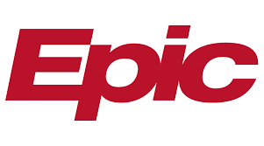

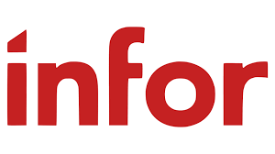

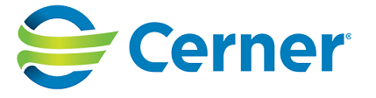
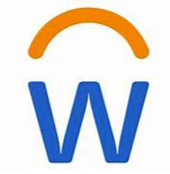


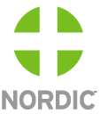
The Evolution of Nordic
Managed Services launched
Launched Advisory Structure
2010
2015
2018
2020
2022
2024
2013
2017
Digital Health launched
2019
2021
2023
Notes:
In 2009 the US Congress passed the HITECH Act (Health Information Technology for Economic & Clinical Health) This moved forward the adoption and meaningful use of Electronic Healthcare Records (EHRs) This was to improve quality, safety and efficiency. Ensure privacy and security. Increase coordination of care. Engage patients in care and improve the health of the population.
In January of 2010, Nordic was founded by two former Epic employees.
Healthtech
Healthtech is based in Canada, specializing in health and technology consulting and operating within a universal healthcare environment. The team's experience and certifications with a vast variety of systems have enabled it to deliver clinical, operational, and financial improvements to healthcare clients for over 35 years.
Bails/ERP Services
ERP Services (formerly known as Bails) delivers the "and technology" consulting component to clients worldwide. With expertise in healthcare and beyond, Bails helps companies in many industries implement, manage, and maintain back-office processes and software. Using proven Infor Deployment Methodology, Bails has enhanced clients' business operations for 25 years.
S&P
S&P's expertise includes clinical, revenue cycle, integration, strategic planning, reporting, and project/program management. In addition, we have an extensive Laboratory IS team fluent in Cerner, Clinisys (fka Sunquest), SCC Soft, and most mainstream LIS systems.
Accrete Health Partners
Accrete Health Partners acquired Nordic Consulting in June 2022. The partnership will anchor Accrete’s growing portfolio, expand Nordic’s health care technology services, and accelerate end-to-end efficiencies for patients, providers, and health systems, primarily in the Managed Services space. Together, we will improve I&T operational performance, capabilities and capacity for our clients.
One of the 2023 Outcomes from Nordic’s Strategic Plan is ‘Improve client digital service delivery.’ The BSMH and RSFH Agreements, highlighted below, help us achieve the goal of ‘Creating a set of offerings from IT assessments through full Managed Services that help our clients right-size their spend and deliver top-of-class digital services and operations to their organizations.’
Bon Secours Mercy Health (BSMH) and Roper St. Francis Health (RSFH)
Nordic expanded its offerings to include a full suite of Managed Services by adding Bon Secours Mercy Health (BSMH), one of the nation’s 20 largest healthcare systems, and Roper St. Francis Healthcare (RSFH), a 657-bed system with 117+ facilities, as clients in July 2023. BSMH and RSFH Information and Technology teams will join Nordic to build an end-to-end managed services organization, focused on serving the healthcare industry. This addition advances Nordic with the innovative, patient-centric capabilities BSMH and RSFH have developed to support world-class patient care for future engagements.
Hygeian
Hygeian is healthcare consulting company based in the United Kingdom. Hygeian has a strong network of 300 highly experienced and skilled management consultants - with a wide range of expertise from clinical, financial, and technical backgrounds - supporting both public and private sector clients across the UK and the Middle East
Nordic Europe
Focusing outside of North America, Nordic Europe helps clients navigate their systems and workflow challenges to meet strategic health and technology needs. Nordic Europe supports clients by navigating the specific requirements of each region, country, and health system with creativity, flexibility, and determination. Locations in Ireland and The Netherlands
Nordic Middle East
We deliver targeted expertise with a focus on value versus cost alone. From hospitals serving local communities to healthcare organizations with nationwide coverage, we believe collaboration across clinical teams and digital initiatives will lead to a healthier population and streamlined processes that benefit providers and patients alike. Located in Dubai
Strategic Advisory
Clinical and Operational Performance Optimization
EHR Implementation and Benefits Realization
BSMH & RSFH
In alignment with our 2023-2025 strategic plan, We are expanding our offerings to now provide our clients with a full suite of managed services. This move represents an evolution from primarily focusing on EHR-agnostic, point solutions to an enhanced portfolio that delivers end-to-end IT support. We are beginning this journey by working with a group of foundational clients, Bon Secours Mercy Health (BSMH) and Roper St. Francis Healthcare (RSFH), who both have an innovative, patient-first approach to information technology.

Slide 29





Nordic’s Culture and Engagement Efforts
COMMUNICATION
RECRUITING PRACTICES
LEARNING RESOURCES
METRICS AND REPORTING
EMPLOYEE RESOURCE GROUPS
Notes:
In our review of our Maxims, the one that most people gravitate to is BE YOU. We want all people from all walks of life to be their authentic selves and we celebrate our differences. No one should have to fake it to be accepted. That is why I am proud to introduce to you our DEI Efforts. Nordic is committed to ensuring diversity, equity, and inclusion as an integral part of who we are as an organization. All employees participate in a DEI learning session during their new employee orientation process.
To keep things at a high level (we will go into each talking point in depth during our DEI training session) we ensure our efforts are clearly communicated, our recruiting efforts reflect our commitment to DEI, we have multiple learning resources to expand your knowledge on DEI, we review and report our standings in diversity as an organization to our CEO and we also have ERGs that are 100% run by current Nordic employees. We would love each of you to be an ally and join an ERG when presented with the opportunity on 1/1/2024
Explain the current areas we’re working on:
Communication: DEI center on NordicHQ, ongoing communications from the organization
Recruiting practices: we’re a member of the Professional Diversity Network so our jobs are advertised on 8 job boards that focus on underrepresented communities; also review our hiring practices to minimize bias
Learning resources: we’ve provided several learning opportunities for all Nordic employees and will continue that work in 2022; BELIEVE learning resources, LOVE learning resources and WISE learning resources are out in the DEI center on Nordic HQ
Metrics: Because DEI is a strategic goal, metrics are reported quarterly to Jim our CEO, and we’re working to ensure our data helps us to understand where we are today and where we can continue to improve
Employee Resource groups – 100% Employee Led

Slide 30
“The expertise is well beyond Epic knowledge. It's really getting into the healthcare and patient access processes, and Nordic is one of the few firms that can do that.”
- Michael Mistretta, SVP and CIO at VHC Health
Notes:
This is one of my favorite quotes from the video.
It captures what makes Nordic stand out in the industry and why we own such a unique place in the market.
I’d love to hear from the group on this. What stood out to you from the video? Please feel free to come off of mute to share your thoughts or add them to the chat.
Look to chat for responses.
Mission is simple, it’s just to be the best health system.
The only way to get to the level we wanted to was to jump into the digital space.
Expanding access to care, improving patient satisfaction. Improved self-sufficiency for patients. 1-11 philosophy, 1 patient, 1 consent, once a year.
< CLICK >

Slide 31
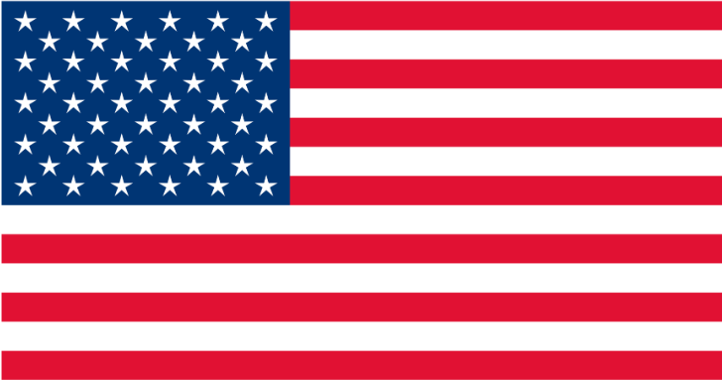
Nordic’s Evolution
Geos
Products
M&As
2010
2012
2014
2016
2018
2020
2022
2024
2026
Notes:
In 2009 the US Congress passed the HITECH Act (Health Information Technology for Economic & Clinical Health) This moved forward the adoption and meaningful use of Electronic Healthcare Records (EHRs) This was to improve quality, safety and efficiency. Ensure privacy and security. Increase coordination of care. Engage patients in care and improve the health of the population.
In January of 2010, Nordic was founded by two former Epic employees.
Healthtech
Healthtech is based in Canada, specializing in health and technology consulting and operating within a universal healthcare environment. The team's experience and certifications with a vast variety of systems have enabled it to deliver clinical, operational, and financial improvements to healthcare clients for over 35 years.
Bails/ERP Services
ERP Services (formerly known as Bails) delivers the "and technology" consulting component to clients worldwide. With expertise in healthcare and beyond, Bails helps companies in many industries implement, manage, and maintain back-office processes and software. Using proven Infor Deployment Methodology, Bails has enhanced clients' business operations for 25 years.
S&P
S&P's expertise includes clinical, revenue cycle, integration, strategic planning, reporting, and project/program management. In addition, we have an extensive Laboratory IS team fluent in Cerner, Clinisys (fka Sunquest), SCC Soft, and most mainstream LIS systems.
Accrete Health Partners
Accrete Health Partners acquired Nordic Consulting in June 2022. The partnership will anchor Accrete’s growing portfolio, expand Nordic’s health care technology services, and accelerate end-to-end efficiencies for patients, providers, and health systems, primarily in the Managed Services space. Together, we will improve I&T operational performance, capabilities and capacity for our clients.
One of the 2023 Outcomes from Nordic’s Strategic Plan is ‘Improve client digital service delivery.’ The BSMH and RSFH Agreements, highlighted below, help us achieve the goal of ‘Creating a set of offerings from IT assessments through full Managed Services that help our clients right-size their spend and deliver top-of-class digital services and operations to their organizations.’
Bon Secours Mercy Health (BSMH) and Roper St. Francis Health (RSFH)
Nordic expanded its offerings to include a full suite of Managed Services by adding Bon Secours Mercy Health (BSMH), one of the nation’s 20 largest healthcare systems, and Roper St. Francis Healthcare (RSFH), a 657-bed system with 117+ facilities, as clients in July 2023. BSMH and RSFH Information and Technology teams will join Nordic to build an end-to-end managed services organization, focused on serving the healthcare industry. This addition advances Nordic with the innovative, patient-centric capabilities BSMH and RSFH have developed to support world-class patient care for future engagements.
Hygeian
Hygeian is healthcare consulting company based in the United Kingdom. Hygeian has a strong network of 300 highly experienced and skilled management consultants - with a wide range of expertise from clinical, financial, and technical backgrounds - supporting both public and private sector clients across the UK and the Middle East
Nordic Europe
Focusing outside of North America, Nordic Europe helps clients navigate their systems and workflow challenges to meet strategic health and technology needs. Nordic Europe supports clients by navigating the specific requirements of each region, country, and health system with creativity, flexibility, and determination. Locations in Ireland and The Netherlands
Nordic Middle East
We deliver targeted expertise with a focus on value versus cost alone. From hospitals serving local communities to healthcare organizations with nationwide coverage, we believe collaboration across clinical teams and digital initiatives will lead to a healthier population and streamlined processes that benefit providers and patients alike. Located in Dubai
Strategic Advisory
Clinical and Operational Performance Optimization
EHR Implementation and Benefits Realization
BSMH & RSFH
In alignment with our 2023-2025 strategic plan, We are expanding our offerings to now provide our clients with a full suite of managed services. This move represents an evolution from primarily focusing on EHR-agnostic, point solutions to an enhanced portfolio that delivers end-to-end IT support. We are beginning this journey by working with a group of foundational clients, Bon Secours Mercy Health (BSMH) and Roper St. Francis Healthcare (RSFH), who both have an innovative, patient-first approach to information technology.

Slide 32
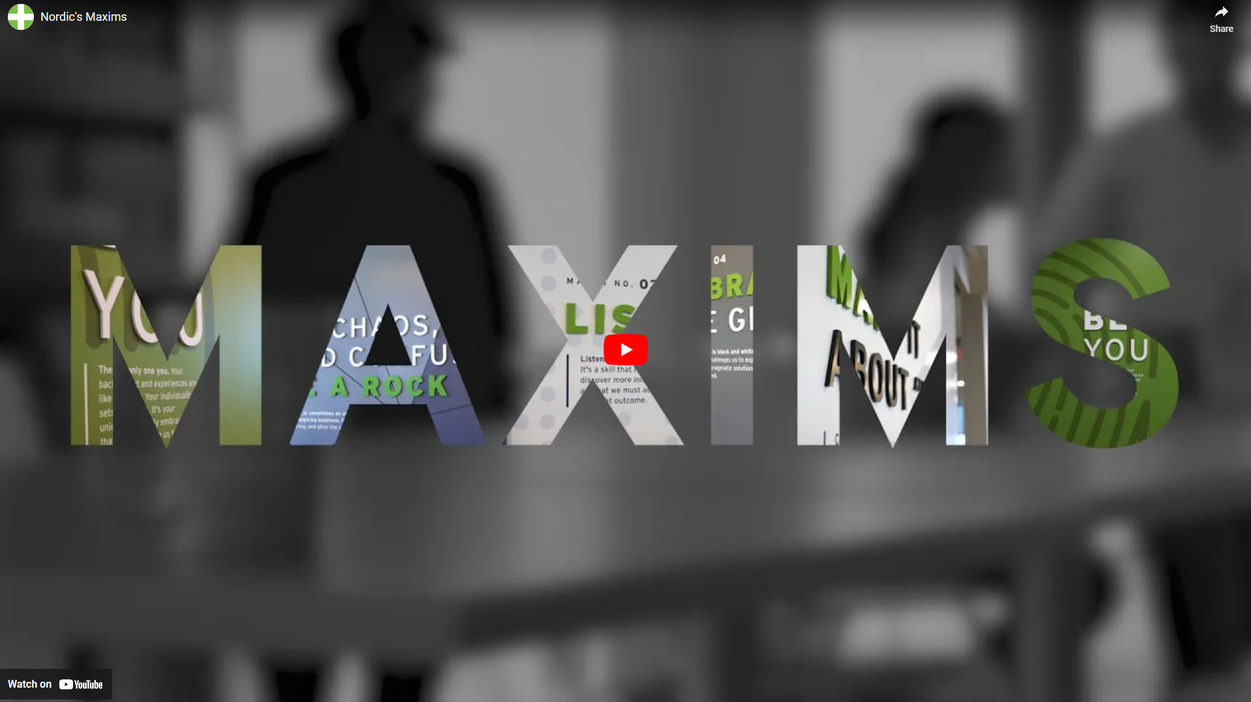
Notes:
This slide is a placeholder to advance to once the video from the previous slide is done playing.

Slide 33

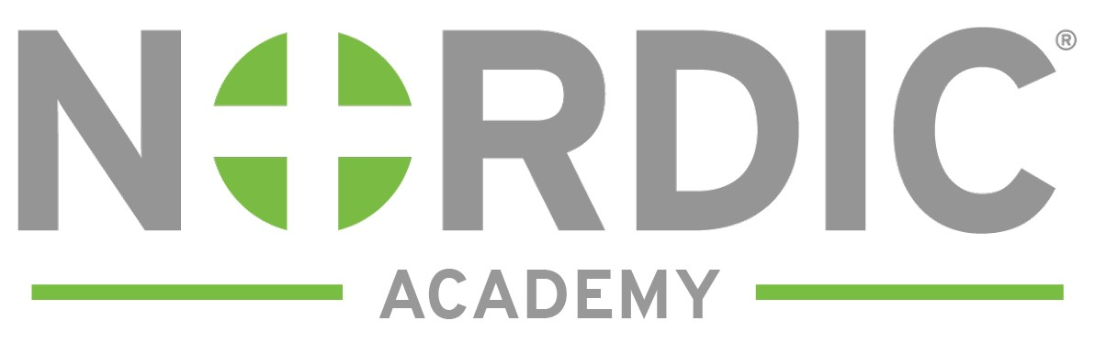
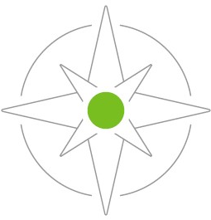
The Business of Nordic
©2024 Nordic®. All rights reserved. Confidential. Edition: 07/02/2024
Notes:
You have joined Nordic Global Health and Technology Consulting! We are so glad to have you as a part of our growing team! Nordic connects people, data, and technology to create a healthier world. It is our people and Maxims that separate us and make us distinct in the marketplace.
Strong partnerships lie at the heart of our work to bring healthcare forward. Our different backgrounds and experiences is what sets us up for success. Both our clients and team members have consistently recognized us as the best in the industry.

Slide 34

Global Health
and Technology Consulting
EUROPE
Global Footprint
CANADA
UNITED STATES
PHILIPPINES
Notes:
3,300+ professionals deployed around the world, 700+ clients
Select map graphic → send to back
Make your edits to the circles, locations, etc.
Select map graphic → bring to front

